Slide 1



AGILE AND SCRUM

Slide 2
PROJECT TITLE:
BUILDING A MOBILE APP
Content:
Project Goal:
Develop a mobile app for personal finance management
Key Features:
Expense tracking
Budget planning
Financial goal setting
Team Members:
Product Owner: Alice
Scrum Master: Bob
Development Team: 5 Developers, 1 Designer, 1 QA Engineer

Slide 3
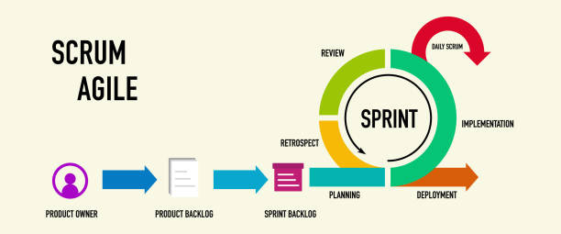
WORKFLOW

Slide 4


SPRINT PLANNING
Sprint Duration:
2 weeks
Planning Meeting:
Review project backlog
Prioritize tasks based on business value
Define Sprint Goal
Sprint Backlog:
Select user stories for the upcoming Sprint
Estimate effort using story points

Slide 5

DAILY STAND-UPS AND SPRINT REVIEW
Daily Stand-ups:
15-minute meeting every day
Each team member answers:
What did I do yesterday?
What will I do today?
Any blockers?
01
Sprint Review:
02
Held at the end of the Sprint
Demonstrate completed features to stakeholders
Gather feedback for improvements

Slide 6

Home
Service
About Us
Contact
SPRINT RETROSPECTIVE
Meeting Focus:
Reflect on the Sprint
Discuss what went well
Identify areas for improvement
01
Action Items:
02
Create a plan for implementing improvements in the next Sprint
Foster continuous learning and adaptation

Slide 7

THANK YOU

